Slide 1

mobile app

Slide 2
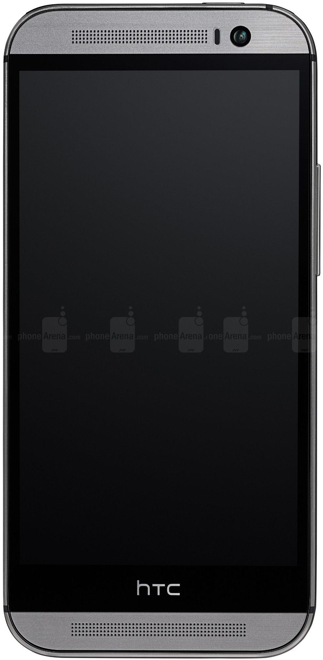






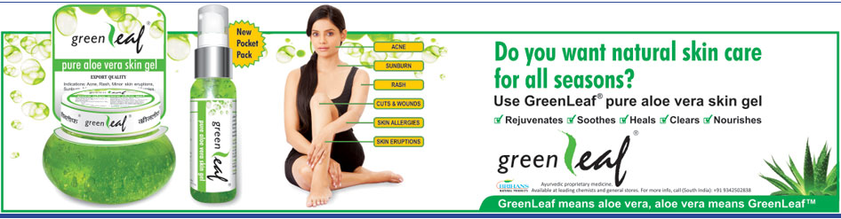


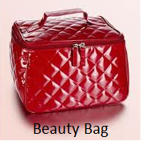
Home Screen
Shopping Bag
Shopping
Bag
Search
Search
Share
Key Offers
Best Deals
Shop Now
Store Locator
Beauty Bag

Slide 3
Use Case #1
Explore Key offers/Best Deals & Add to Shopping Bag

Slide 4

Swipe to see all key offers and Best Deals
Swipe to see the key offers
Shopping
Bag
Search
Swipe to see Best Deals

Slide 5


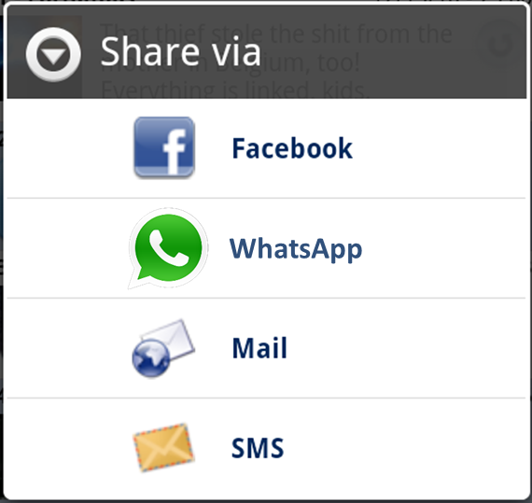
Share offers with friends
Shopping
Bag
Search
Tap to Share

Slide 6

Add an offer to the Bag
Tap to see Product Details
Shopping
Bag
Search
Tap to see Product Details

Slide 7

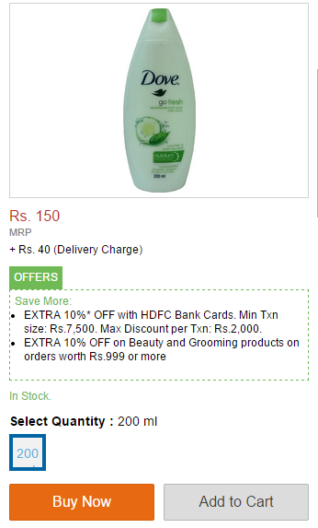


Offer details | Add to Bag
1
Bag updated
2
H&G Price
Our Price:
Rs. 129
Product Details Here
Choose quantity
Click here to add to Bag
1
ADD TO BAG
Click here to go back

Slide 8
Use Case #2
Shop Now

Slide 9
Shop Now
Click here to Shop Now
Shopping
Bag
Search

Slide 10
Shop Now
Swipe to see more products
Shopping
Bag
Product Images
Swipe to see more products
Product Images
Swipe to see more products
Product Images
Click here to see other Products
Other Products

Slide 11
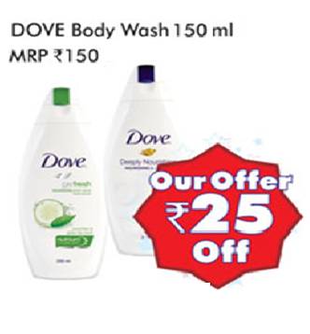



View Products
3
Beauty Care > product | brand
Scroll to view all products
ADD TO BAG
ADD TO BAG

Slide 12


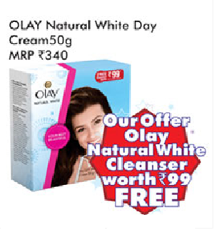
Tap to view Product Details
3
Beauty Care > product | brand
Click to Add product to Bag
ADD TO BAG
Click to View Product Description
ADD TO BAG

Slide 13

Product Details | Add to Bag
3
Click here to checkout Shopping Bag
H&G Price
Our Price:
Rs. 129
Product Details Here
Choose quantity
1
Click here to add to Bag
ADD TO BAG

Slide 14




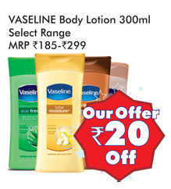
Shopping Bag Checkout
3
Swipe to remove from Bag
Our Price: Rs. 129
Dove Body Wash 250 ml
Quantity: 1
UNDO adds back product
Our Price: Rs. 1,250
Lakme Cosmetics Entire Range
Quantity: 1
Product removed from Bag
Our Price: Rs. 299
Vaseline Body Lotion 150 ml
Quantity: 1
Click here to check out
Proceed to Checkout

Slide 15

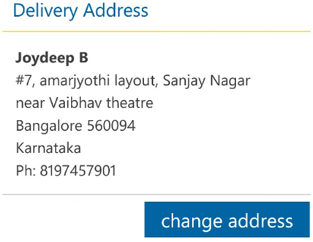
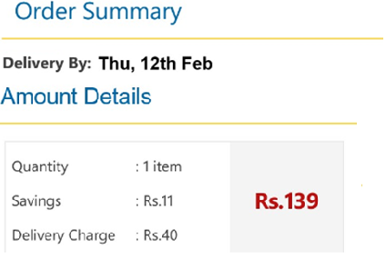

Buy Online
3
Click here to change address
Click here to proceed

Slide 16
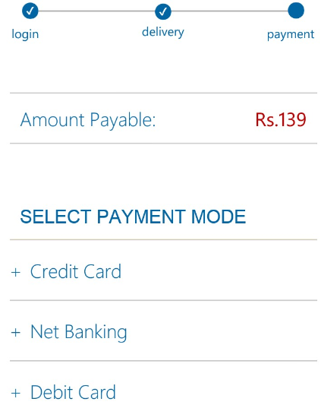
Buy Online
3
Click here to select mode

Slide 17
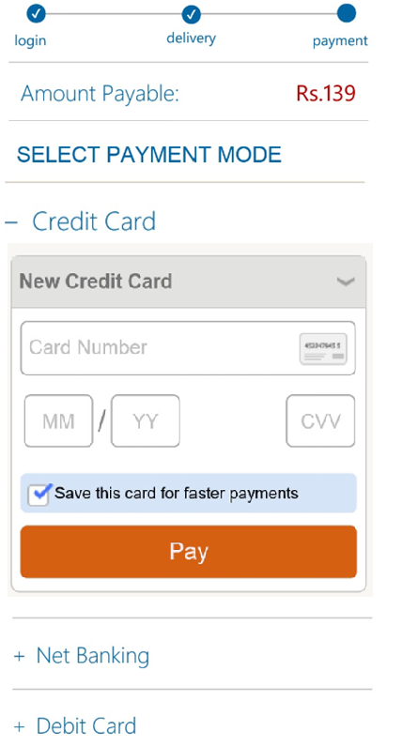
Buy Online
3
Click here to Pay

Slide 18
Use Case #3
Store Locator

Slide 19
Locate a Store
Shopping
Bag
Search
Click to locate a store

Slide 20




Select Store
Click to see list of stores in the city
1
2
Select Store
Click to Select a store

Slide 21
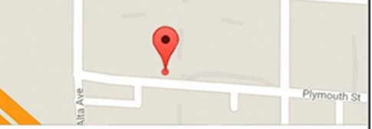
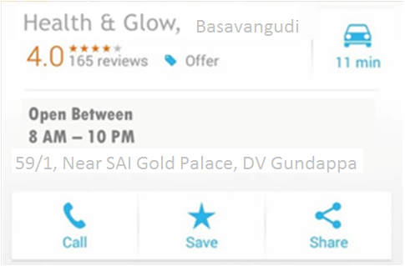
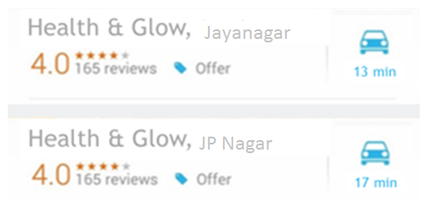
Select Store
1
2
Google Map
59/1, Near Sai Gold Palace, DV Gun…
Google Maps redirection
Nearest stores to this location
GPS-based nearest store

Slide 22
Use Case #4
Beauty Bag

Slide 23
Locate a Store
Shopping
Bag
Search
Beauty Bag
MY LOVES
MY DESIRES

Slide 24
My Loves
3
MY LOVES
Our Price: Rs. 129
Dove Body Wash 250 ml
Quantity: 1
Recently Purchased Products
Our Price: Rs. 1,250
Lakme Cosmetics Entire Range
Quantity: 1
Our Price: Rs. 299
Vaseline Body Lotion 150 ml
Quantity: 1

Slide 25
Locate a Store
Shopping
Bag
Search
Beauty Bag
MY LOVES
MY DESIRES

Slide 26
My Desires
3
MY DESIRES
Our Price: Rs. 134
Vaseline Body Lotion 250 ml
Quantity: 1
My Wish List
Our Price: Rs. 213
Lakme Cosmetics Entire Range
Quantity: 1
Our Price: Rs. 178
Dove Body Wash 150 ml
Quantity: 1

Slide 27
Thank you!

